Slide 1
Comparison of Neural Architectures for Sentiment Analysis of Movie Reviews
Sören Hübner and Nicolás Pérez de Olaguer
Notes:
1/22/19
1
1

Slide 2

Motivation
People search for and are affected by Online opinions
i.e. Trip Advisor, Goodreads, Amazon, Yelp,…
Internet Movie Database (IMDb)
Over 5 million titles
Over 80 million users
Would not be useful to see if a movie review is positive or negative?
How? Sentiment Analysis using Natural Language Processing (NLP)
Sören Hübner
Nicolás Pérez de Olaguer
Sentiment Analysis of Movie Reviews
2
Notes:
1/22/19
2
2

Slide 3
Outline
1. Motivation and Question
2. Basics and Definition
3. Approach
4. Results
5. Discussion
6. Conclusion
Sören Hübner
Nicolás Pérez de Olaguer
Sentiment Analysis of Movie Reviews
3
Notes:
1/22/19
3
3

Slide 4
2. Sentiment Analysis
An easy approach would be:
Count number of positive and negative words.
If: Positive > Negative = Positive Review
Else: Negative Review
Other option would be weighting keywords.
i.e. amazing = +2, awful = -3
Not so easy… Imagine this example:
I used to hate the topic but this stuff is yuummy! ☺
Let us find something more elaborated!
Sören Hübner
Nicolás Pérez de Olaguer
Sentiment Analysis of Movie Reviews
4
Notes:
1/22/19
4
4

Slide 5
2. Sentiment Analysis
Current state-of-the-art is word model creation.
Finding temporal relations, rhetorical uses, …
Can deal with: Polarity flippers, multiword expressions ( slang), subtle sentiments, …
Different examples like:
Word2vec
Bag of Words
Embedding vector
Sören Hübner
Nicolás Pérez de Olaguer
Sentiment Analysis of Movie Reviews
5
Notes:
1/22/19
5
5

Slide 6
3. Approach
Import IMDB review corpus. Properly labelled.
Data pre-processing.
Create a word model (embedding vector).
Train different Neural Networks approaches for binary classifications.
Multi Layer Perceptron (MLP)
Convolutional Neural Network (CNN)
Long Short-Term Memory (LSTM)
Sören Hübner
Nicolás Pérez de Olaguer
Sentiment Analysis of Movie Reviews
6
Notes:
1/22/19
6
6

Slide 7
3. Approach - Dataset
Imported from Keras library. In this case, already pre-processed.
Dataset of 25,000 movies reviews.
Each review is encoded as a sequence of word indexes (integers).
Indexed by overall frequency in the dataset.
Division between Training and Test Set.
Sören Hübner
Nicolás Pérez de Olaguer
Sentiment Analysis of Movie Reviews
7
Notes:
1/22/19
7
7

Slide 8
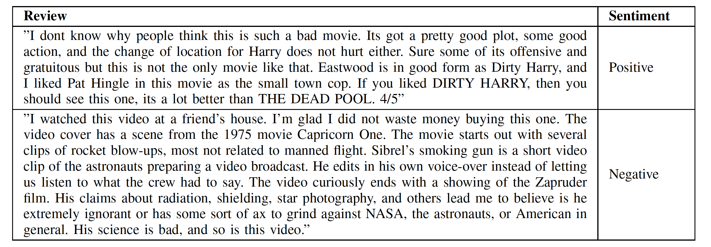
3. Approach – Dataset example
Clear examples of positive and negative reviews.
Sören Hübner
Nicolás Pérez de Olaguer
Sentiment Analysis of Movie Reviews
8
Notes:
1/22/19
8
8

Slide 9
3. Approach – Embedding Vector
We first used Word2vec model. Gave us decent to good results.
We tried Keras embedding vector. Similar concept but not the same. [1, 2]
Gave us better and faster results.
We are ready to train!
Sören Hübner
Nicolás Pérez de Olaguer
Sentiment Analysis of Movie Reviews
9
Notes:
1/22/19
9
9
So, you cannot say that the Embedding layer in Keras is doing the same as word2vec [2]. Remember that word2vec refers to a very specific network setup which tries to learn an embedding which captures the semantics of words. With Keras's embedding layer, you are just trying to minimize the loss function, so if for instance you are working with a sentiment classification problem, the learned embedding will probably not capture complete word semantics but just their emotional polarity...

Slide 10
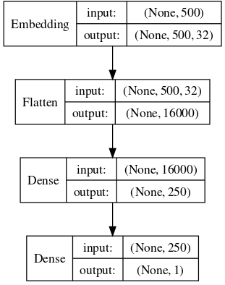
3. Approach – MLP
“Multi-Layered Perceptron“
Simpler ANN approach. Useful for binary classification.
250 fully connected layer + ReLu activation function.
As good as other more
complex architectures with simple tasks.
Sören Hübner
Nicolás Pérez de Olaguer
Sentiment Analysis of Movie Reviews
10
Notes:
1/22/19
10
10

Slide 11
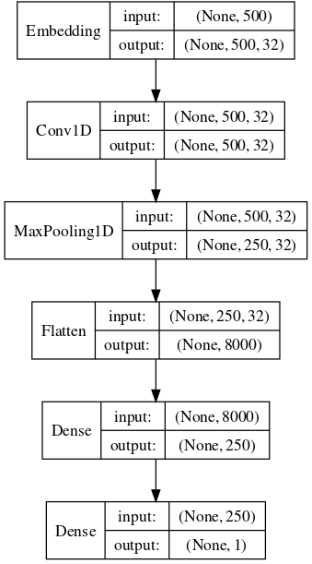
3. Approach – CNN
Convolutional Neural Network useful for feature learning.
Convolution always followed by a max pooling layer.
In the end of the layer stack, we have a MLP for binary classification.
Why? Learn a higher level of abstraction of the data.
Sören Hübner
Nicolás Pérez de Olaguer
Sentiment Analysis of Movie Reviews
11
Notes:
1/22/19
11
11

Slide 12
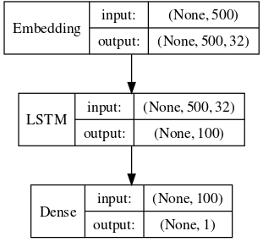
3. Approach - LSTM
“Long Short-Term Memory“ type of Recurrent Neural Network (RNN).
Captures time dependencies of the data.
Good candidate since words have a strong dependencies with previous and next word neighbours.
Used a lot for text predictions.
MLP binary classification as last layer.
Sören Hübner
Nicolás Pérez de Olaguer
Sentiment Analysis of Movie Reviews
12
Notes:
1/22/19
12
12

Slide 13
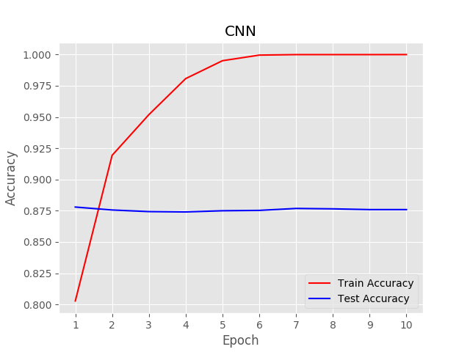
4. Results - CNN
Sören Hübner
Nicolás Pérez de Olaguer
Sentiment Analysis of Movie Reviews
13
Notes:
1/22/19
13
13

Slide 14
5. Discussion
For the three models, accuracy greater than 85 % achieved.
CNN is the best approach in the task, with an accuracy of 87.59 % after 10 epochs.
Networks might be too big.
LSTM costly trained. Not worth it.
Kaggle Competition → Position 267 / 578
Sören Hübner
Nicolás Pérez de Olaguer
Sentiment Analysis of Movie Reviews
14
Notes:
1/22/19
14
14

Slide 15
6. Conclusion
Indeed good classification results.
CNN does not add a significant better result than a MLP.
Similar performance of models
Open Questions:
Check for objective and subtle reviews
Apply dropout not to overfit the networks
Sören Hübner
Nicolás Pérez de Olaguer
Sentiment Analysis of Movie Reviews
15
Notes:
1/22/19
15
15

Slide 16
The End
Thank you for your attention.
Any question?
Sören Hübner
Nicolás Pérez de Olaguer
Sentiment Analysis of Movie Reviews
16
Notes:
1/22/19
16
16

